Slide 1
PM10 Corporate Insights: Social Media and News Analysis
Corporate Insights Analyst Exec Accessment
by Wong Ee Shen

Slide 2
My approach to this accessment
Cleaned and prepared data in Excel
Built insights and visuals using Tableau
To achieve the technical and aesthetics requirements
Goal is to understand public sentiment, platform activity, and influencer engagement around PM10

Slide 3
01
When did the conversation pick up, peak and tapered off?

Slide 4
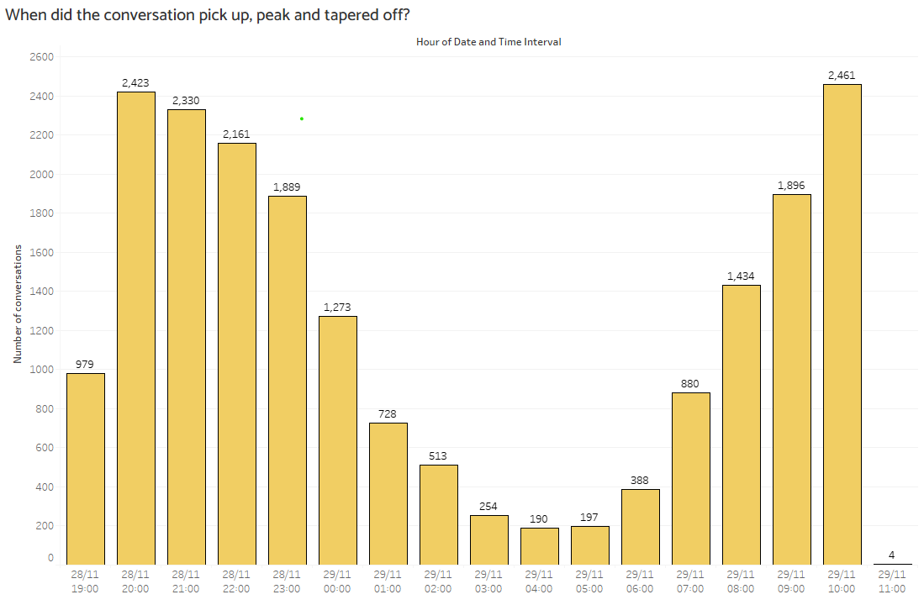
01: When did the conversation pick up, peak and tapered off?
As shown in the chart, conversation activity began around 8 PM on November 28. It slowly tapered off approaching midnight, then picked up again the following morning as people started to wake up.

Slide 5
02
Where did the conversation come from?

Slide 6
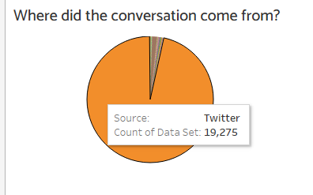
02: Where did the conversation come from?
Most conversations originated from Twitter, while other platforms contributed a smaller share. To explore how each Channel Type contributes to the discussion, use the Channel Type filter in the Tableau dashboard at the end of this presentation. The chart will update dynamically based on your selection.

Slide 7
03
What did the public feel about the issue?

Slide 8
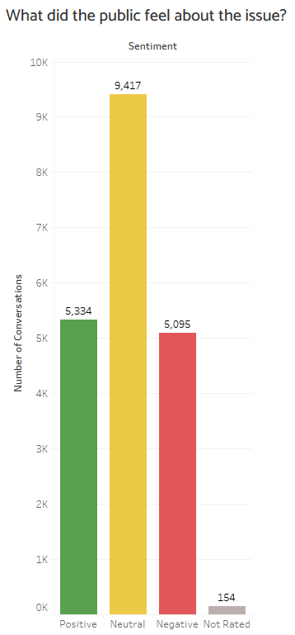
03: What did the public feel about the issue?
Most of the public sentiment toward the issue is neutral. Among the remaining responses, positive sentiment slightly outweighs negative sentiment, indicating a generally balanced public reaction.

Slide 9
04
Who generates the most buzz?

Slide 10
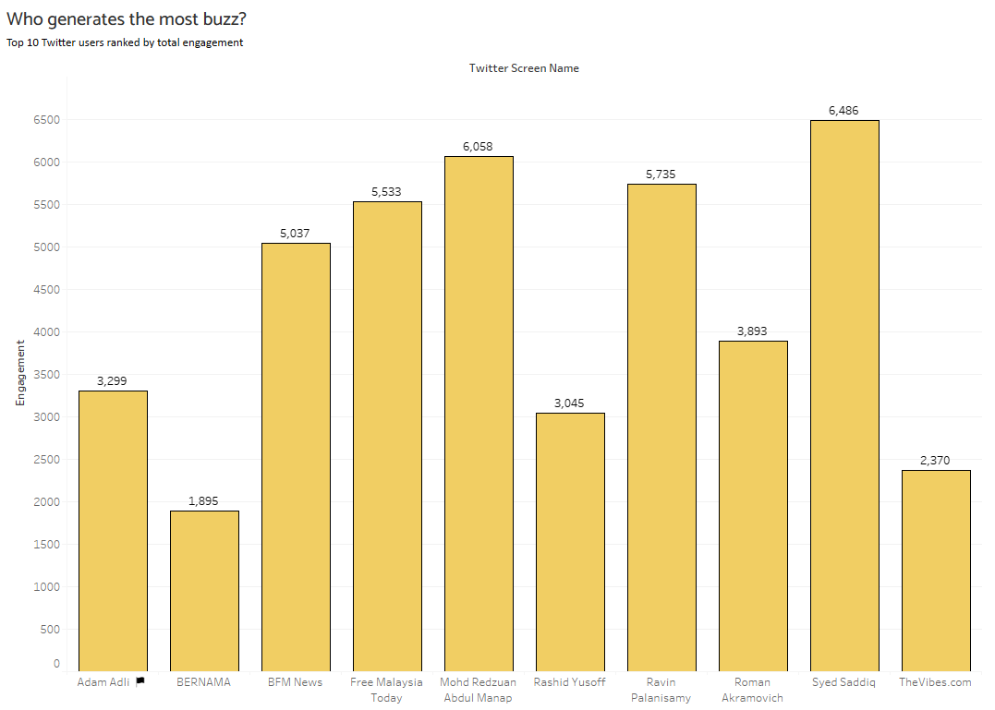
04: Who generates the most buzz?
As shown in the graph, these are the top 10 Twitter users ranked by total engagement. Syed Saddiq generated the most buzz on Twitter.

Slide 11
05
How many unique users talked about the issue?

Slide 12
05: How many unique users talked about the issue?
A total of 8444 unique users talked about the issue across 67 different sources.

Slide 13
06
What are the top hashtags used?

Slide 14
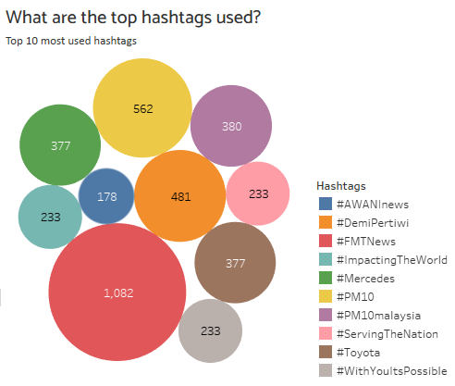
06: What are the top hashtags used?
As shown in the graph, these are the top 10 most used hashtags.

Slide 15
07
Which gender talked about the issue most?

Slide 16
07: Which gender talked about the issue most? (NOT AVAILABLE)
Gender information was not included in the dataset and could not be reliably deduced from available fields such as screen names or usernames.
No assumptions were made regarding the gender of users. As a result, this question could not be answered using the provided data.

Slide 17
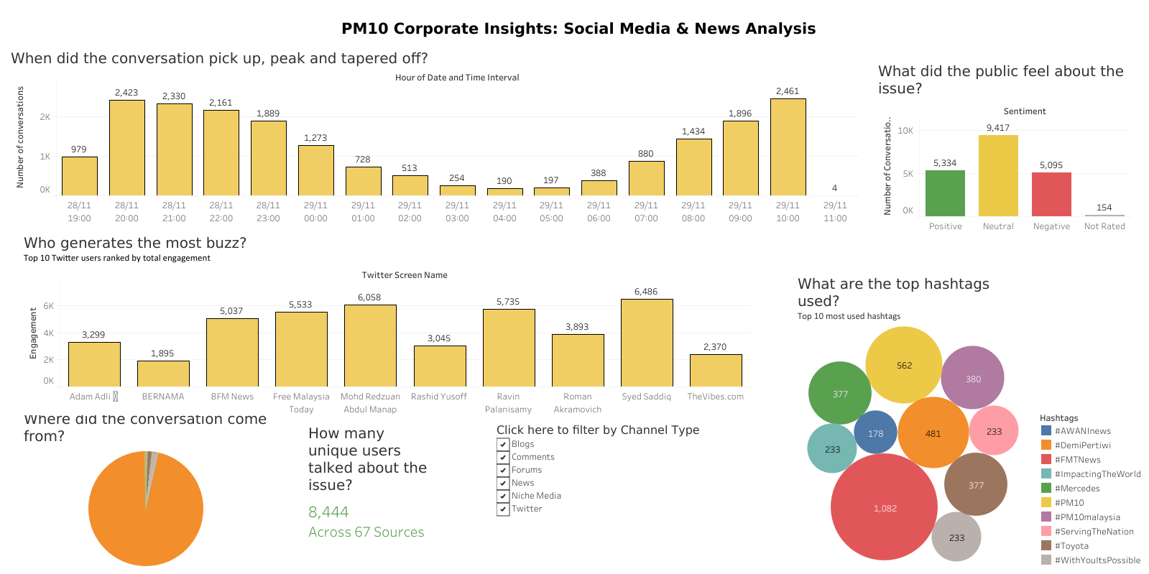
Tableau Dashboard
Link: https://public.tableau.com/app/profile/ashton.wong/viz/Book1_17517014528350/Dashboard1

Slide 18
One recommendation
Brands and stakeholders should closely monitor emerging conversations on Twitter, as Twitter could potentially show early signs of public sentiment shifts.

Slide 19
THANK YOU!

